Slide 1
섹션6-1 우리도 YAML 을 사용하자 (application.yml)
--- # Configuration Port
server:
port: 8081
--- # Configuration Thymeleaf
spring:
thymeleaf:
prefix: classpath:/templates
suffix: .html
cache: false
--- # Configuration Devtools
spring:
devtools:
livereload:
enabled: true
restart:
enabled: false
--- # Configuration MariaDb
spring:
datasource:
driver-class-name: org.mariadb.jdbc.Driver
url: jdbc:mariadb://localhost:3307/boot
username: boot
password: boot
# Configuration mybatis
# mybatis.mapper-locations=classpath:sqlmap/**/*.xml
# mybatis.configuration.map-underscore-to-camel-case=true
IT늦공 김부장

Slide 2
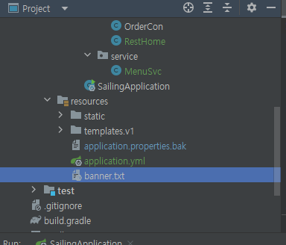
섹션6-2 우리도 Banner 를 꾸며보자
banner.txt 위치
배너생성 사이트 참고
https://devops.datenkollektiv.de/banner.txt/index.html
http://patorjk.com/software/taag
IT늦공 김부장

Slide 3
섹션6-3 Thymeleaf - 헤더 / 푸터 설정하기
header.html
<!DOCTYPE html>
<html lang="ko" xmlns:th="http://www.thymeleaf.org">
<th:block th:fragment="headerFragment">
<div class="topnav">
<a href="/v1/home">Home ^^</a>
<a href="/v1/menu">커피메뉴</a>
<a href="/v1/order">주문내역</a>
<a href="/v1/member">고객정보</a>
</div>
</th:block>
</html>
<!-- 헤더 위치 -->
<th:block th:replace="/v1/comm/header :: headerFragment"></th:block>
<!-- 푸터 위치 -->
<th:block th:replace="/v1/comm/footer :: footerFragment"></th:block>
footer.html
<!DOCTYPE html>
<html lang="ko" xmlns:th="http://www.thymeleaf.org">
<th:block th:fragment="footerFragment">
<div class="footer">
<!-- https://www.w3schools.com/html/html_emojis.asp -->
<h4>[Footer] <span style="font-size:30px;">&#9973;</span> Spring boot 항해 ~ with Me ^^</h4>
</div>
</th:block>
</html>
IT늦공 김부장

